Slide 1

Problem Solving Session
The remainder of today’s class will comprise the problem solving session (PSS).
Your instructor will divide you into teams of 3 or 4 students.
Each team will work together to solve the following problems over the course of 20-30 minutes.
You may work on paper, a white board, or digitally as determined by your instructor.
You will submit your solution by pushing it to GitHub before the end of class.
Your instructor will go over the solution before the end of class.
If there is any time remaining, you will begin work on your homework assignment.
Class participation is a significant part of your grade (20%). This includes in class activities and the problem solving session.
Your Course Assistants will grade your participation by verifying that you pushed your solutions before the end of the class period each day.

Slide 2

Problem Solving Team Members
Record the name of each of your problem solving team members here.
Do not forget to add every team member’s name! Your instructor (or course assistant) may or may not use this to determine whether or not you participated in the problem solving session.

Slide 3
Problem Solving 1
Speed
Consistency
Frequency of Collisions
The quality of a hashing function is based on three characteristics.
Speed - the time complexity of the function.
Consistency- given the same input, does the function always produce the same output?
Frequency of Collisions - how likely is it that two different values will have the same hash code?
In the space to the right, explain why each of these characteristics is important, and how a bad hash function would perform in each area.

Slide 4
Problem Solving 2
One possible hash function would use the sum the value of the ASCII characters in a string as the hash code for the string.
Implement such a function in the space to the top left. Remember, you can use the built-in ord() function to convert a character into its ASCII value (an integer).
In the space to the bottom left, discuss how you think this hash function would perform relative to the three characteristics (speed, consistency, and frequency of collisions).

Slide 5
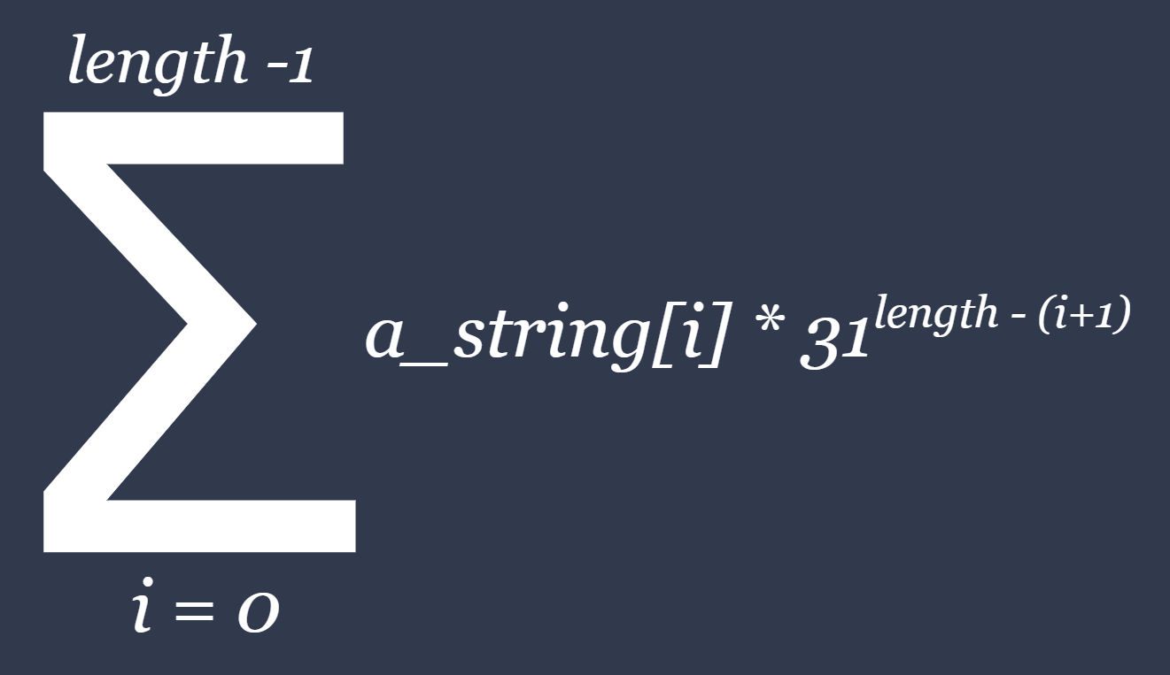
Problem Solving 3
Another hashing function modifies the ASCII values of the characters in a string in some way rather than simply adding them together. Consider the following function:
Implement a hash function that uses this formula in the space on the top right. Then, in the space to the bottom right, discuss how you think this hash function would perform relative to the three characteristics (speed, consistency, and frequency of collisions).

Slide 6
Problem Solving 4
One way to count collisions is to use a list of integers, initially set to all 0s, and then increment the value at each index as collisions occur. If the value at an index is 0 or 1, no collisions occurred. For any other value C when C > 1, the number of collisions is C - 1, e.g. if the value is 5, then 4 collisions occurred.
Let t be the total number of collisions counted in such a list, and i be the total number of indexes at which at least one collision occurred. The average number of collisions is therefore t / i.
Write a function that, given a list in which the collisions at each index have been counted, computes and returns the total number of collisions and the average number of collisions.

